Slide 2
Kerusso stands unwaveringly with Israel.
Through our commitment over the years, we’ve financially supported ministries working on the front lines, ministering to Israelis throughout the Holy Land.
Show your support AND protect people in Israel with two specially designed T-shirts.
Each shirt is more than mere apparel. It’s a statement of solidarity, AND it makes a tangible difference in Israel through charitable relief efforts.

Slide 3
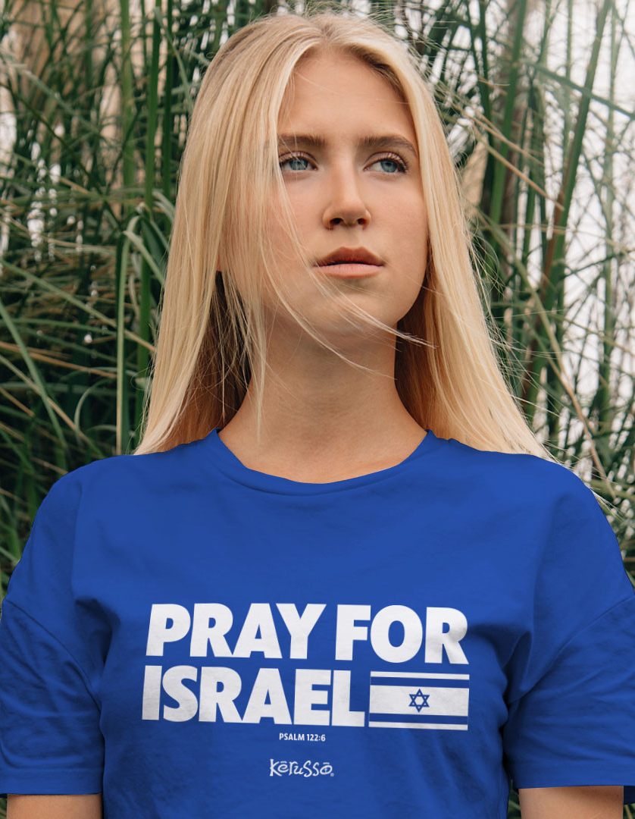
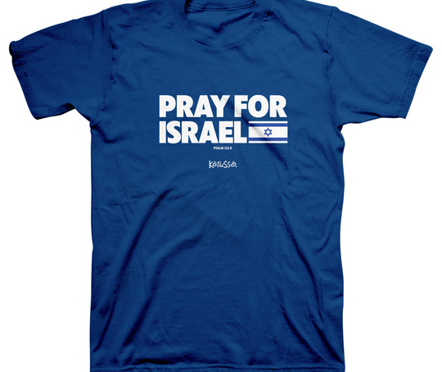
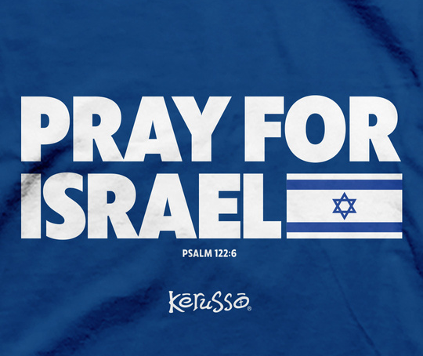
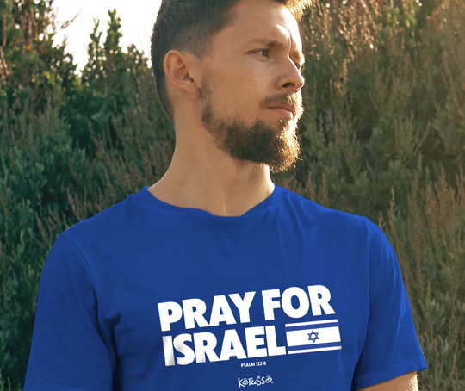
Pray For Israel
APT4722 S-3X

Slide 4
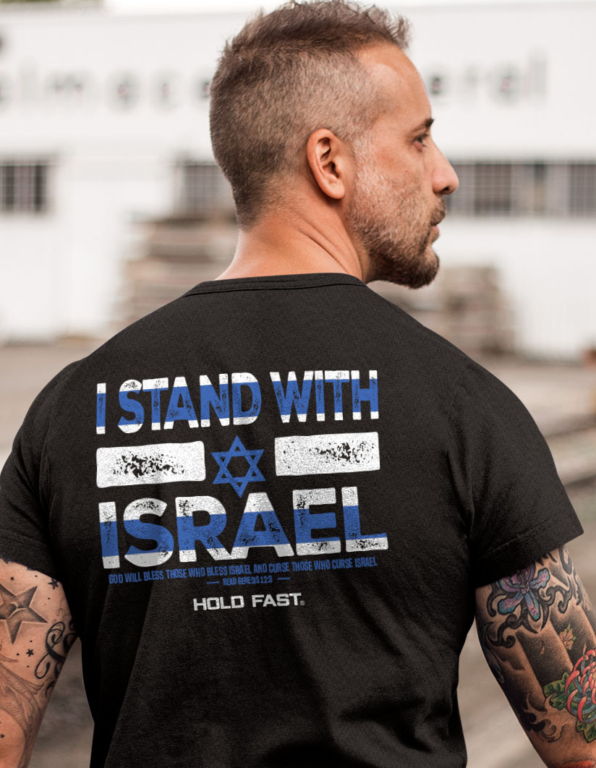
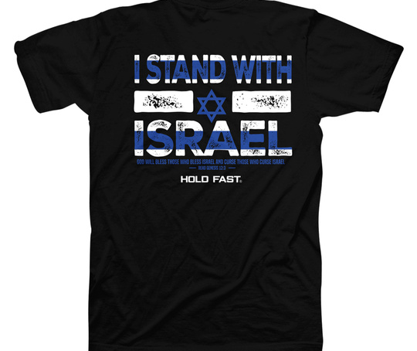
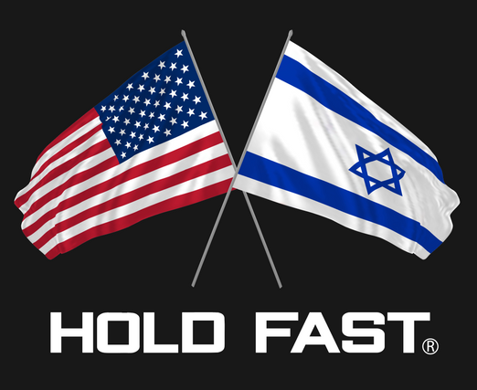
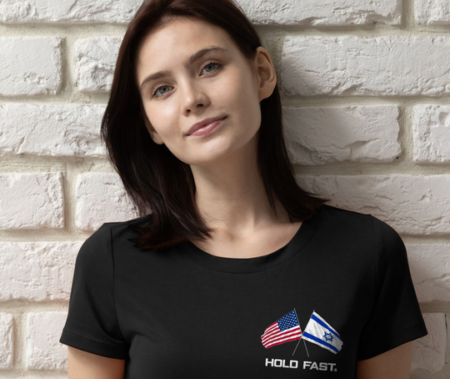
Back T-shirt
Front Chest Print
I Stand With Israel
KHF4723 S-3X
Front Chest Print

Slide 5
With every shirt you purchase, Kerusso will donate $5.00 to the Friends of Israel Gospel Ministry or Frontier Alliance International.
Both ministries have been instrumental in providing support to the Israeli people, ensuring they have the resources and protection they need in these challenging times.
When missiles threaten the skies of Israel, your support helps provide bomb shelters, giving citizens those crucial 10–14 seconds to find safety.
When a Lone Soldier in the IDF (Israel Defense Forces) seeks solace during the Sabbath, your support provides them with a welcoming family.
When a woman needs to escape the clutches of domestic violence, your support offers her a safe haven.
And when emergency medical assistance is needed, your support provides major equipment like ambulances.
By wearing these T-shirts, you’re not just making a fashion statement. You’re making a statement of faith, hope, and love. You’re standing with Israel, and you’re making a difference in the lives of those who need it most.
Friends of Israel Gospel Ministry
Frontier Alliance International

Slide 7
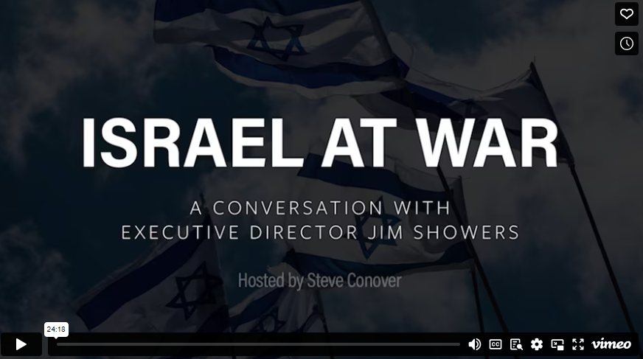

Slide 8
Join us in this mission.
#StandWithIsrael
#PrayForIsrael

